Slide 1
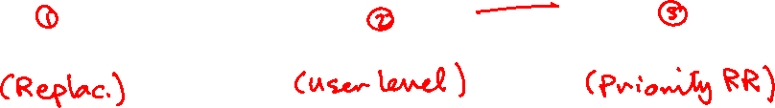
OS’24 Project
Milestone 3: CPU
FAULT HANDLER Ii, SEMAPHORES & scheduler

Slide 2

Agenda
Logistics
Part 0: Code Updates
Part 1: Fault Handler II (Replacement)
Part 2: User-Level Semaphores
Part 3: Priority RR Scheduler
OVERALL Testing
BONUSES
Summary & Quick Guide
How to submit?

Slide 3
Logistics
Dependency:
MS1: dynamic allocator (alloc_block_FF, free_block)
MS2: kernel heap (kmalloc, kfree, k_virtial_address & k_physical_address)
MS2: placement
MS2: shared memory (smalloc, sget)
Delivery Method: GOOGLE FORM
It’s FINAL delivery
MUST deliver the required tasks and ENSURE they’re worked correctly
Delivery Dates:
SAT of Week #13 (21/12 @11:59 PM)
Upload your code EARLY as NO EXCEPTION will be accepted.
Support:
The support for teams will be through their MENTORS ONLY (+Lecturer) during via:
MAIN METHOD: weekly office hours.
SECONDARY METHOD [OPTIONAL]: other contact method [MUST declare your Team# first]

Slide 4

Logistics
ADVICE#1: WORK AS A TEAM
Milestone 3: CPU
Fault Handler II: 1 functions
Semaphores: 4 functions
CPU Scheduling: 4 functions
OVERALL Testing
ADVICE#2: START immediately!
To have the chance to ask and to understand errors in your code in whatever you want during your mentor’s support before the deadline.
ADVICE#3: MUST read the ppt & doc CAREFULLY
Detailed steps
Helper ready made functions (appendices)
≈ ~1-2 Functions/member + OVERALL Testing
on 3 Weeks
INDEPENDENT
Modules
L1 ➔ 4 FUNCTIONS - L2 ➔ 4 FUNCTIONS - L3 ➔ 1 FUNCTION

Slide 5
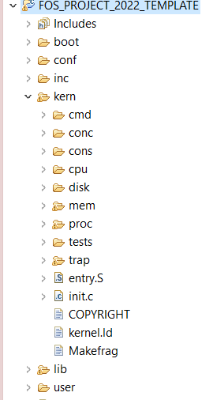




PROJECT BIG PICTURE
inc (.h)
CPU Sched.
(Priority RR)
lib (.c)
Fault Handler II
(Replacement)
Semaphore
[MS1] Preprocessing
user
kern
[MS2] MEMORY
CPU Sched
[MS3] CPU
Fault Handler II
Semaphore

Slide 6
Code Updates
PART0: PREREQUISITES

Slide 7
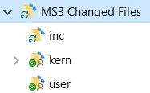
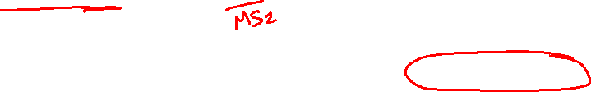
New Files
SELECT ALL in the given “Changed files” folder,
COPY & PASTE (REPLACE ALL) in FOS_CODES/FOS_PROJECT_2024_TEMPLATE/
NOTE: If any of these files are already edited by you in MS1, make sure to apply the edits in the new files

Slide 8
Code Modification
Inside kern/trap/fault_handler.h, apply the following changes:
Modify the data type of page_WS_max_sweeps variable:
Notes:
if (!is_initialized)
{
uint32 required_size = size + sizeOfMetaData();
uint32 da_start = (uint32)sbrk(required_size);
//get new break since it's page aligned! thus, the size can be more than the required one
uint32 da_break = (uint32)sbrk(0);
initialize_dynamic_allocator(da_start, da_break - da_start);
}

Slide 9
Code Modification
Inside inc/memlayout.h, apply the following changes:
ADD the following line at any location after line#155:
#define PGFLTEMP(UTEMP - PAGE_SIZE)
Notes:
if (!is_initialized)
{
uint32 required_size = size + sizeOfMetaData();
uint32 da_start = (uint32)sbrk(required_size);
//get new break since it's page aligned! thus, the size can be more than the required one
uint32 da_break = (uint32)sbrk(0);
initialize_dynamic_allocator(da_start, da_break - da_start);
}

Slide 10
Given Codes
APPENDICES:
ENTRY MANIPULATION in TABLES and DIRECTORY
PAGE FILE HELPER FUNCTIONS
WORKING SET STRUCTURE & HELPER FUNCTIONS
SCHEDULER STRUCTURE & HELPER FUNCTIONS
MEMORY MANAGEMENT FUNCTIONS
READY-MADE COMMANDS

Slide 11
CAUTION
During your solution, any SHARED data need to be PROTECTED by critical section via LOCKS
REMEMBER: Ensure CORRECTNESS by DESIGN

Slide 12
Protection Test (after MS2)
FOS> run tst_protection 5000
Successful message should occur…

Slide 13

Agenda
Logistics
Part 0: Code Updates
Part 1: Fault Handler II (Replacement)
Part 2: User-Level Semaphores
Part 3: Priority RR Scheduler
OVERALL Testing
BONUSES
Summary & Quick Guide
How to submit?

Slide 14
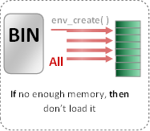


Load Program [env_create] [already DONE]
Now: in Project
THREE kernel dynamic allocations:
create_page_table(): create new page table and link it to directory.
create_user_directory(): create new user directory.
create_user_kern_stack(…): create new user kernel stack.
Prev: in Labs
env_create( )
BIN
Set of pages
Required Tables
All Pages
BIN
Segment 1, page 1
Loaded in virtual address 201000
201000
WS_Last_element
Segment 1, page 2
Loaded in virtual address 202000
202000
Refer to APPENDICES for:
Segment 1, page 3
203000
Loaded in virtual address 203000
Segment 2, page 1
801000
Page File Helper Functions
Loaded in virtual address 801000
Segment 2, page 2
USTAKTOP —PAGESIZE
NOT Loaded in main memory
Program Binary Segments and pages
Working Set after loading (pages_WS_size = 5)
Working Set Structure & Helper Functions
First Stack Page
Ready-Made Commands

Slide 15
Fault Handler II: Replacement
The main functions required by MS3 to handle “Page Fault” are:
# | Function | File
1 | page_fault_handler | Functions definitions TO DO in: kern/trap/fault_handler.c

Slide 16
Fault Handler II: Introduction
Fault: is an exception thrown by the processor (MMU) to indicate that:
A page table is not exist in the main memory (i.e. new table). (see the following figure) OR
A page can’t be accessed due to either it’s not present in the main memory

Slide 17
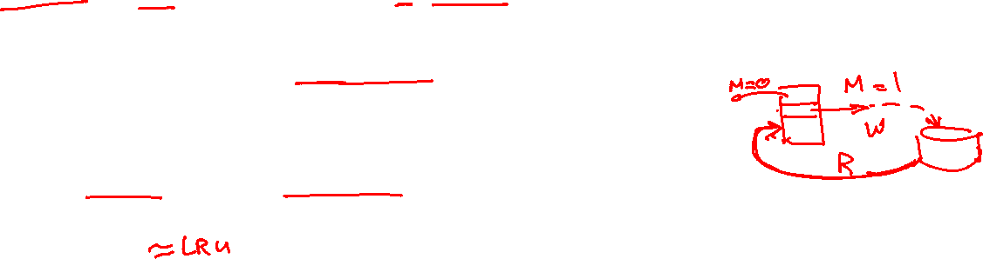
Replacement: N^{th} Chance Clock – Idea
N^{th} chance algorithm: Give page N chances
OS keeps counter per page: # sweeps
Start searching from the WS element after the last placed one (i.e. FIFO)
On page fault, OS checks use bit:
0⇒increment counter; if count=N, replace page
1⇒clear use and also clear counter (used in last sweep)
Means that clock hand has to sweep by N times without page being used before page is replaced
What about modified pages?
Takes extra overhead to replace it, so give it an extra chance before replacing?
Common approach: * Clean pages: use N * Modified pages: use N+1

Slide 18
Replacement: N^{th} Chance Clock – Idea
How do we pick N?
Why pick large N? Better approximation to LRU
If N ~ 1K, really good approximation
Why pick small N? More efficient
Otherwise might have to look a long way to find free page

Slide 19
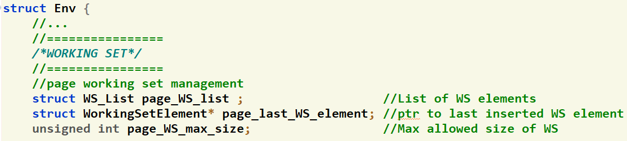
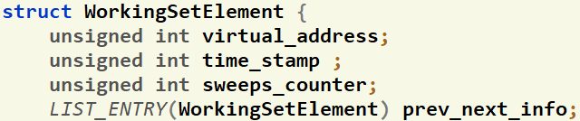

Working Set: Structure
IMP. NOTE: you should maintain page_last_WS_element & correct FIFO order of the List in rest of code (page_fault_handler, free_user_mem …)
inc/environment_definitions.h
Each Element
FIFO, CLK & N^{th} CLK
Proc Limit
inc/environment_definitions.h
Each process has a working set LIST that is initialized in env_create()
Its max size is set in "page_WS_max_size" during the env_create()
"page_last_WS_element" will point to either:
the next location in the WS after the last set one If list is full.
Null if the list is NOT full.
This list hold pointers to struct containing info about the currently loaded pages in memory.
Each struct holds two important values about each page:
User virtual address of the page
Number of sweeps (+ve: NORMAL Ver, -ve: MODIFIED Ver.)

Slide 20

Working Set: Structure
kern/trap/fault_handler.h
MAX number of sweeps for the N^{th} chance clock replacement algorithm:
If +ve: NORMAL algorithm.
If -ve: MODIFIED algorithm.

Slide 21
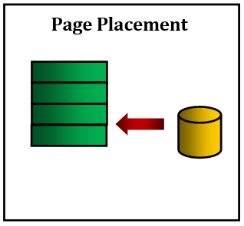
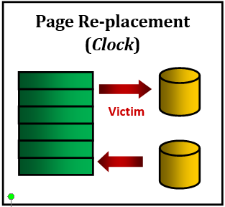
#1: Nth CLK Re/placement
Refer to APPENDICES for:
Page File Helper Functions
(N^{th} Chance CLK)
Working Set Structure & Helper Functions
page_fault_handler(struct Env * curenv, uint32 fault_va)
if(isPageReplacmentAlgorithmNchanceCLOCK())
{
if the size of page_WS_list < its max size, then do
{
Scenario 1: Placement
//[DONE in MS2]: [PROJECT’24.MS2] PAGE FAULT HANDLER – Placement
}
else
{
Scenario 2: Replacement
//TODO: [PROJECT’24.MS3 - #1] [1] PAGE FAULT HANDLER – Nth CLK Replac.
}
}

Slide 22
Page Fault Handler: Switching…
To switch the replacement from the FOS prompt:
FOS> nclock <N> 1 ➔ switch the replacement to Nth Chance Clock (NORMAL Version)
FOS> nclock <N> 2 ➔ switch the replacement to Nth Chance Clock (MODIFIED Version)
To switch the replacement from the code:
Inside the FOS_initialize() in “kern/init.c”:
setPageReplacmentAlgorithmNchanceCLOCK(int N); ➔ set Nth Chance Clock replacement
If +ve: NORMAL algorithm.
If -ve: MODIFIED algorithm.

Slide 23

Page Fault Handler: SEEN Testing
"Congratulations!! test [TEST NAME] completed successfully.”
To ensure the test success, a congratulations message like this MUST appear without any ERROR messages or PANICs.
Test each function in MS3 independently in a FRESH SEPARATE RUN
The time limit of each individual test: max of 15 sec / each
All below tests are used to validate the page_fault_handler with Nth Chance Clock function
# | Test Functionality | Test
1 | tst_page_replacement_alloc.c (tpr1): tests allocation in memory and page file after page replacement. | FOS> run tpr1 11
2 | tst_page_replacement_stack.c (tpr2): tests page replacement of stack (i.e. new pages) (creating, modifying and reading them) | FOS> run tpr2 6
3 | tst_page_replacement_nthclock_1.c (tnclock1): tests page replacement by N^{th} Chance CLK algorithm [NORMAL version] (it checks working set before & after replacements) | FOS> nclock 5 1 FOS> run tnclock1 11
4 | tst_page_replacement_nthclock_2.c (tnclock2): tests page replacement by N^{th} Chance CLK algorithm [MODIFIED version] (it checks working set before & after replacements) | FOS> nclock 5 2 FOS> run tnclock2 11

Slide 24
Page Fault Handler: UNSEEN Testing
# | Test Functionality
1 | tests page replacement by N^{th} Chance CLK algorithm (check maintaining of page_last_WS_element & correct FIFO order of the List after free_user_mem)
2 | tests page replacement by N^{th} Chance CLK algorithm (check effect of large N vs normal clock (N = 1))
3 | tests page replacement by N^{th} Chance CLK algorithm (check # disk writes in NORMAL vs. MODIFIED)

Slide 25
Agenda
Logistics
Part 0: Code Updates
Part 1: Fault Handler II (Replacement)
Part 2: User-Level Semaphores
Part 3: Priority RR Scheduler
OVERALL Testing
BONUSES
Summary & Quick Guide
How to submit?

Slide 26
User-Level Semaphores
The main functions required by MS3 to handle “Semaphores” are:
# | Function | File
1 | create_semaphore() | All essential declarations in: inc/semaphore.h Functions definitions TO DO in: lib/semaphore.c
2 | get_semaphore()
3 | wait_semaphore()
4 | signal_semaphore()

Slide 27
User-Level Semaphores – Overview
Operations:
Initialize by non-negative value
semWait:
decrements the value
If value < 0 ➔ process is blocked
Else ➔ process continues execution
3 Operations are
atomic
semSignal:
increments the value.
If value ≤ 0 ➔ unblock a process (make it Ready)
Notes:
1. A semaphore may be initialized to a nonnegative integer value.
2. The semWait operation decrements the semaphore value.
If the value becomes negative, then the process executing the semWait is blocked.
Otherwise, the process continues execution.
3. The semSignal operation increments the semaphore value.
If the resulting value is less than or equal to zero, then a process blocked by a semWait operation, if any, is unblocked.

Slide 28

User-Level Semaphores – Overview
struct semaphore {
int count;
queueType queue;};
void semWait(semaphore s)
{ int keyw = 1;
do xchg(&keyw, &s.lock) while (keyw != 0);
s.count--;
if (s.count < 0) {
/* place this process in s.queue */;
/* block this process */;
}
s.lock = 0; }
void semWait(semaphore s)
{ s.count--;
if (s.count < 0) {
/* place this process in s.queue */;
/* block this process */;}
}
lock = 0
acquire()
(must also set s.lock = 0) */; WHERE?
release()
void semSignal(semaphore s)
{
s.count++;
if (s.count ≤ 0) {
/* remove a process P from s.queue */;
/* place process P on ready list */;}
}
void semSignal(semaphore s)
{ int keys = 1;
do xchg(&keys, &s.lock) while (keys != 0);
s.count++;
if (s.count ≤ 0) {
/* remove a process P from s.queue */;
/* place process P on ready list */;}
s.lock = 0; }
acquire()
release()
Notes:
Do we need to disable the interrupt before trying to exchange?
Ans: yes! since if just after acquiring the lock, an interrupt occur, the service routine will be busy-waiting on the lock & will not return ➔ deadlock!

Slide 29

User-Level Semaphores – Overview
Usage:
Critical Section

Slide 30

User-Level Semaphores – Overview
Usage:
Synchronization

Slide 31
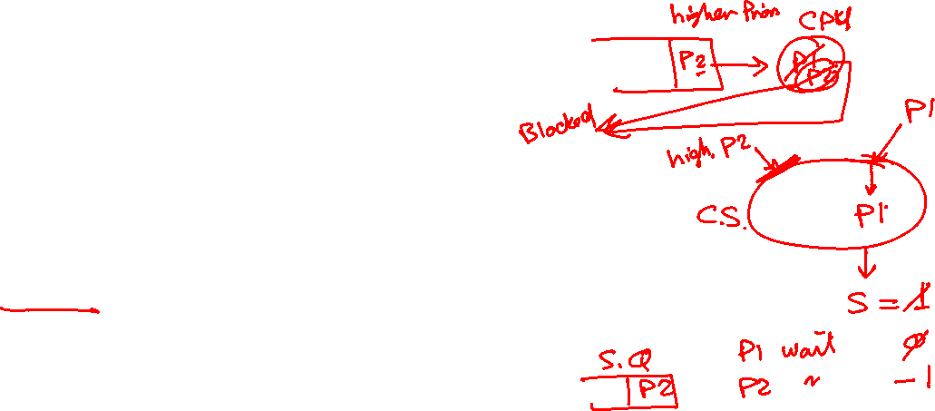
User-Level Semaphores – Overview
Pros:
No busy-waiting
Applicable to any number of processes
Applicable on Uni or Multi processors
Support multiple critical sections
No starvation
selection of a waiting process is FIFO
No deadlock in Priority Inversion (if code is correctly written!)
when a low-priority process interrupted inside CS,
High-priority can’t enter CS, will be BLOCKED state
Low-priority can continue

Slide 32
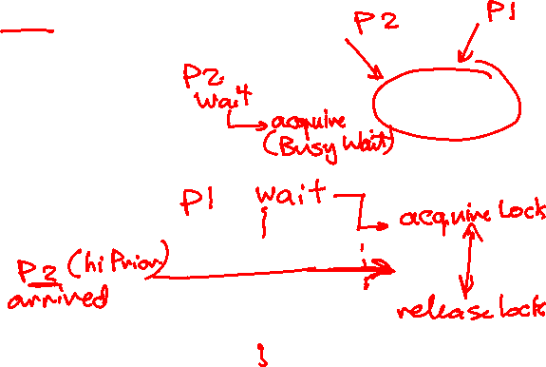
User-Level Semaphores – Overview
Cons:
Semaphores are dual purpose, slight change in order of wait’s ➔ deadlock!!
Deadlock in Priority Inversion of its lock
when a low-priority process acquires the lock then interrupted,
High-priority executes ➔ busy-waiting on the lock
Low-priority can’t resume! Deadlock!
Solutions:
priority promotion
Priority donation

Slide 33
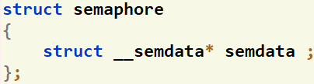
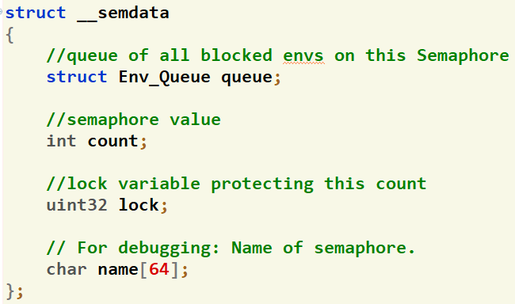

User-Level Semaphores – Givens
Data Structures:
inc/semaphore.h
Wrapper
For data protection

Slide 34

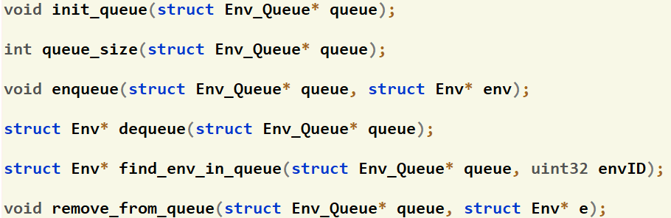
User-Level Semaphores – Givens
Refer to APPENDICES for:
Scheduler Functions
Queuing Functions:
kern/cpu/sched_helpers.h

Slide 35

#2: Create Semaphore
lib/semaphore.c
struct semaphore create_semaphore(char *semaphoreName, uint32 value)
Dynamically allocates the semaphore as a shared object (to allow other processes to share it)
Initializes its members
Return: object from the wrapper semaphore

Slide 36

#3: Get Semaphore
lib/semaphore.c
struct semaphore get_semaphore(int32 ownerEnvID, char* semaphoreName)
Get the shared semaphore object
Return: object from the wrapper semaphore

Slide 37
#4: Wait
Refer to APPENDICES for:
Scheduler Functions
lib/semaphore.c
void wait_semaphore(struct semaphore sem)
Implement the logic of the “wait” function
Refer to the previous pseudocode for details

Slide 38
#5: Signal
Refer to APPENDICES for:
Scheduler Functions
lib/semaphore.c
void signal_semaphore(struct semaphore sem)
Implement the logic of the “signal” function
Refer to the previous pseudocode for details

Slide 39

User-Level Semaphores: SEEN Test
"Congratulations!! test [TEST NAME] completed successfully.”
To ensure the test success, a congratulations message like this MUST appear without any ERROR messages or PANICs.
Test each function in MS3 independently in a FRESH SEPARATE RUN
The time limit of each individual test: max of 30 sec / each
All below tests are used to validate the 4 functions TOGETHER
# | Test Functionality | Test
1 | tst_semaphore_1master.c (tsem1): tests the implementation of wait & signal by using the Semaphores for handling the critical section and the dependency. | FOS> run tsem1 100
2 | tst_semaphore_2master.c (tsem2): tests the implementation of wait & signal by using the Semaphores for allowing certain number of processes to enter the critical section at the same time. | FOS> run tsem2 100 Enter total # cust’s: 100 Enter shop capacity: 30
3 | MidTermEx_Master.c (midterm): tests the effect of race condition in simple concurrent execution of two processes that attempt to edit same shared variables (X & Y). Try it with & without using semaphores (observe the final value of X, is it same each time?) | FOS> run midterm 100
ProcA {
Y = X * 2;
X = Y;
Signal(T);
}
ProcB {
Wait(T)
Z = X + 1;
X = Y;
}

Slide 40
User-Level Semaphores: UNSEEN Test
# | Test Functionality
1 | Tests a complete concurrent program using semaphores (e.g. barber shop, prod cons, …etc)

Slide 41
Agenda
Logistics
Part 0: Code Updates
Part 1: Fault Handler II (Replacement)
Part 2: User-Level Semaphores
Part 3: Priority RR Scheduler
OVERALL Testing
BONUSES
Summary & Quick Guide
How to submit?

Slide 42

Priority RR Scheduler: Overview
Refer to APPENDICES for:
Scheduler Functions
WHAT?
multiple ready queues to represent each level of priority
Preemptive on clock
At any given time:
the scheduler chooses a process from the highest-priority non-empty queue.
If the highest-priority queue contains multiple processes, then they run in "round robin" order.
…
P₄
P₁
CPU
…
P₆
P₂
Decreasing Priority
…
…
P₈
P₇
P₁₂
…
P₅
P₃

Slide 43
Priority RR Scheduler: Overview
Refer to APPENDICES for:
Scheduler Functions
PROBLEM
Lower-priority may suffer starvation if there is a steady supply of high priority processes.
SOLUTION
Allow a process to change its priority based on its age (IF #TICKS EXCEEDS CERTAIN THRESHOLD)
…
P₄
P₁
CPU
…
P₆
P₂
Decreasing Priority
…
…
P₈
P₇
P₁₂
…
P₅
P₃

Slide 44
Priority RR Scheduler: Overview
Refer to APPENDICES for:
Scheduler Functions
REMEMBER
During your solution, any SHARED data need to be PROTECTED by critical section via LOCKS

Slide 45
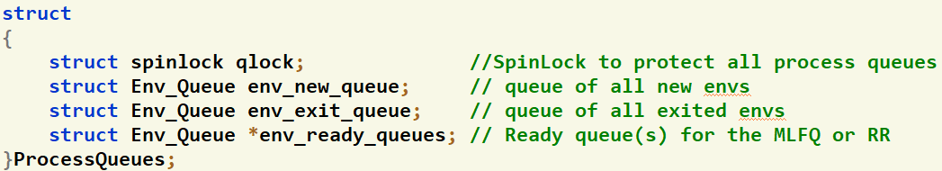
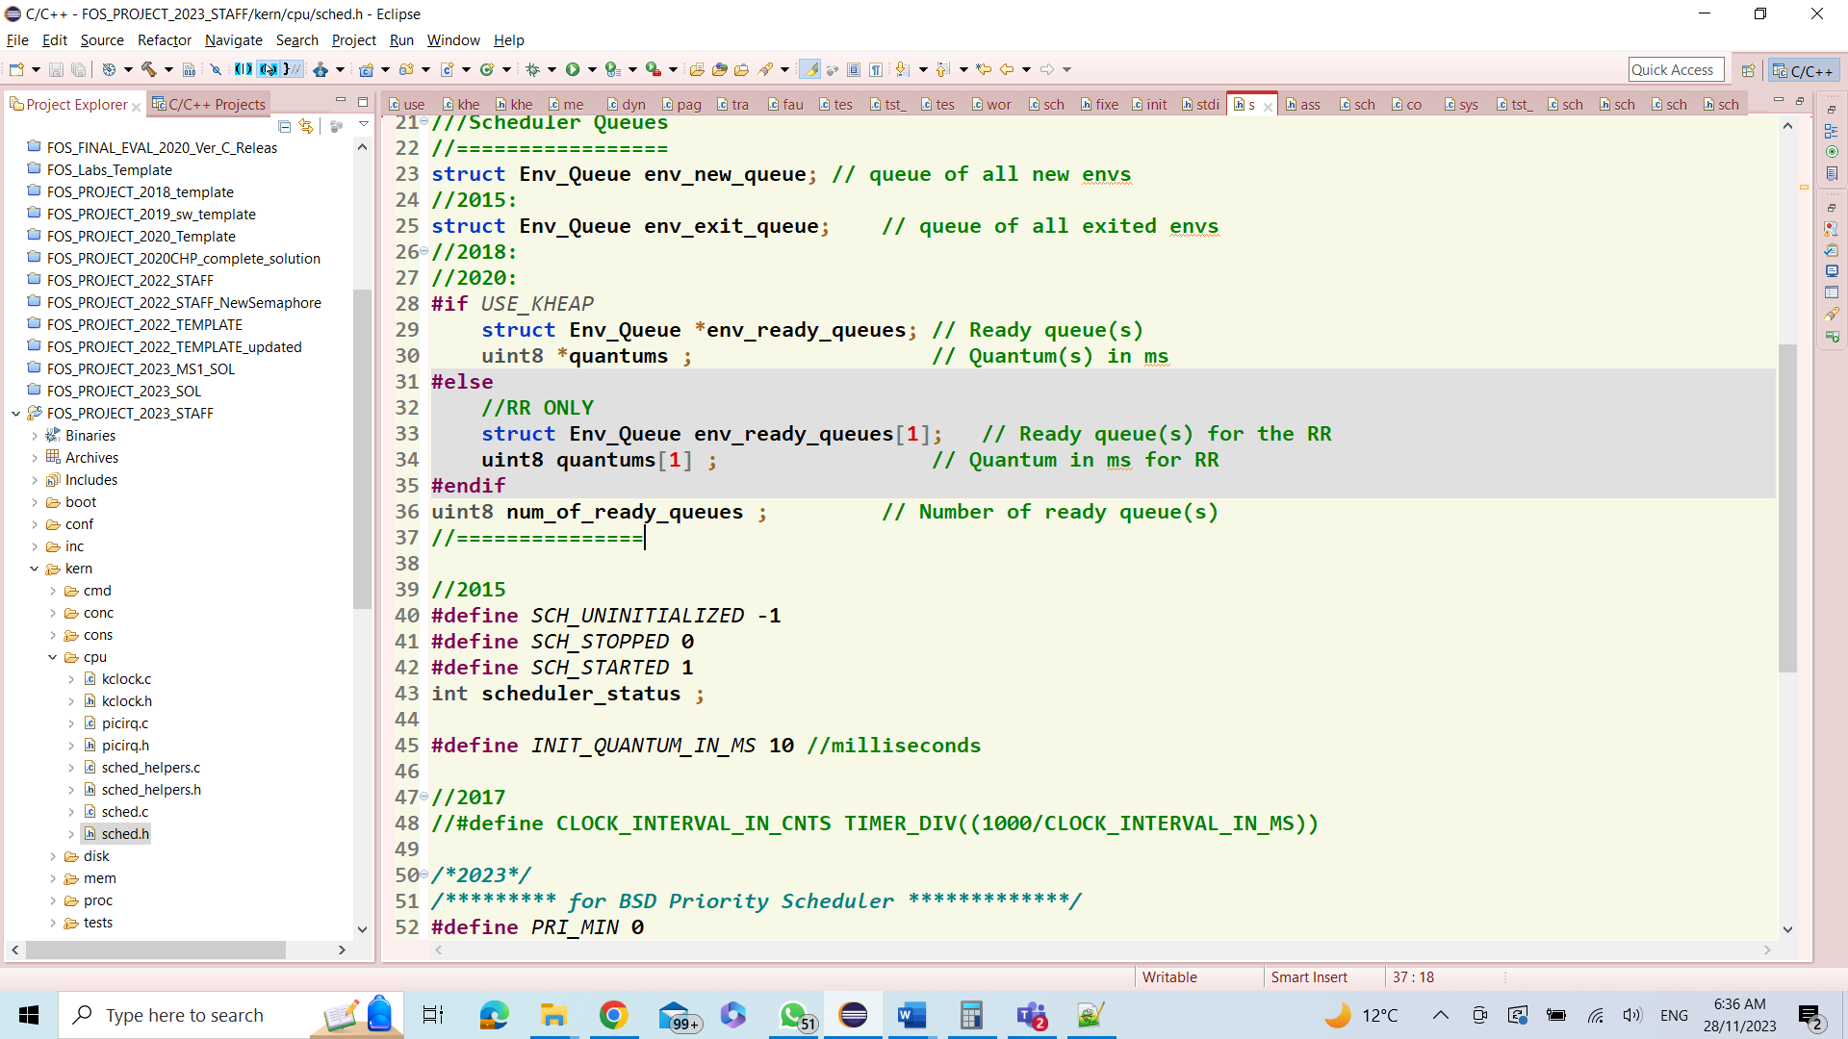
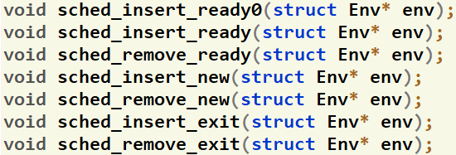
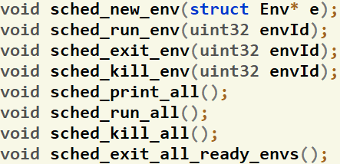

Given Data Structures & Functions
Refer to APPENDICES for:
Scheduler Functions
Queues
kern/cpu/sched.h
CPU Scheduler
Queues Function
kern/cpu/sched_helpers.c
Sched Function
kern/cpu/sched_helpers.c
Insert process in the corresponding ready queue (based on priority)
MUST be called in the entire project instead of sched_insert_ready0

Slide 46

Given Commands
FOS> run <prog_name> <page_WS_size> [<priority>]
FOS> load <prog_name> <page_WS_size> [<priority>]
FOS> setPri <envID> <priority>
FOS> setStarvThr <starvationThreshold>
FOS> runall
FOS> printall
FOS> sched?
Refer to APPENDICES for:
Ready-Made Commands

Slide 47

#6: Set Process Priority & Thresh
Refer to APPENDICES for:
Scheduler Functions
void env_set_priority(int envID, int priority)
New System Call
void sys_env_set_priority(int32 envID, int priority)
kern/cpu/sched_helpers.c
Description:
Set the priority of the given process by the given priority value
If it’s in READY state, update its location in the ready queues
Description:
Implement and handle a new system call to set the priority of the user process from user level
Should call the env_set_priority(…) from the kernel
Should be named as sys_env_set_priority(…)
Refer to MS#1 for steps
void sched_set_starv_thresh(uint32 starvThresh)
Description:
Set the starvation threshold by the given value
Testing: UNSEEN: test at your own

Slide 48

#7: Initialize Priority RR Scheduler
Refer to APPENDICES for:
Scheduler Functions
void sched_init_PRIRR(uint8 numOfPriorities, uint8 quantum, uint32 starvThresh)
New Command
FOS> schedPRIRR <numOfPriority> <quantum> <starvThresh>
kern/cpu/sched.c
kern/cmd/commands.c
Description:
Initialize the Priority RR scheduler by the given number of priorities, CPU quantum (in millisecond) and starvation threshold
Do other initializations (if any)
Should use the following global variables for initialization (declared in kern/cpu/sched.h)
Description:
Switch & initialize the scheduler to PRIORITY RR with given #priorities, quantum and starvation threshold
Should call the sched_init_PRIRR(…)
Should be named as schedPRIRR
Testing:
UNSEEN: test at your own

Slide 49

#8: Schedule Next Process
Refer to APPENDICES for:
Scheduler Functions
struct Env* fos_scheduler_PRIRR()
Description:
If there’s a current process on the CPU, place it in the corresponding ready queue (do any required initializations)
Select the next environment to be run on the CPU and return it
REMEMBER to se the CPU quantum

Slide 50
#9: Timer Tick Handler
Refer to APPENDICES for:
Scheduler Functions
void clock_interrupt_handler()
Description:
This handler is automatically called every “quantum” period
Should be used to promote any process that exceeds the starvation threshold
IF #TICKS IT EXCEEDS THE STARVATION THRESHOLD

Slide 51

Priority RR Scheduler: Switching…
To switch the scheduler from the FOS prompt:
FOS> schedPRIRR <#priorities> <quant> <starvThresh>
➔ switch the scheduler to Priority RR with the given #priorities, quantum and starvation threshold
FOS> schedRR <quantum>
➔ switch the scheduler to RR with the given quantum

Slide 52
Priority RR Scheduler: Testing
Refer to APPENDICES for:
Ready-Made Commands
Scheduler Functions
UNSEEN Tests…
As a guide, you can use the given set of ready-made programs to test the following aspects:
Load & run multiple instances from the same program with different “priority” values.
Load & run different set of programs with same or different “priority” values and compare!
Write a master program that create & run a large number of different processes with different needs (i.e. cpu, I/O, memory).
Use sys_create_env() and sys_run_env()
…

Slide 53

Priority RR Scheduler: Testing
Refer to APPENDICES for:
Ready-Made Commands
Scheduler Functions
UNSEEN Tests…
Example: Run 2 instance of Fibonacci with different priorities
LARGE starvation threshold
FOS> schedPRIRR 5 10 1000
FOS> load fib 100 0 //priority 0
FOS> load fib 100 4 //priority 4
FOS> runall
SMALL starvation threshold
FOS> schedPRIRR 5 10 10
FOS> load fib 100 0 //priority 0
FOS> load fib 100 4 //priority 4
FOS> runall
LARGE: observe that the 2nd program will not start until the 1st one finishes
SMALL: observe that the 2nd program will start during the execution of the 1st one (due to priority promotion)

Slide 54
Agenda
Logistics
Part 0: Code Updates
Part 1: Fault Handler II (Replacement)
Part 2: User-Level Semaphores
Part 3: Priority RR Scheduler
OVERALL Testing
BONUSES
Summary & Quick Guide
How to submit?

Slide 55

Modular Tests: Dependency Graph
allocate & free
Dynamic Allocator
kmalloc, kvirtual, kphysical
Kernel Heap
Invalid Access
(tia)
PLACEMENT (tpp)
Share1 (create)
Priority RR Scheduler
Malloc2
(BLOCK ALLOC)
Malloc1
(PAGE ALLOC)
tpr2 (STACK)
tpr1 (ALLOC)
Share2 (Get)
Share3 (create: special cases)
Free2
(BLOCK ALLOC)
Free1
(PAGE ALLOC)
tnclock1 (NORM)
tnclock2 (MODIF)
Sem1
(wait&signal)
First Fit 2
(BLOCK ALLOC)
First Fit 1
(PAGE ALLOC)
First Fit 3
(normal & shared)
Sem2
(wait&signal)
midterm
(wait&signal)

Slide 56
Project ENTIRE Tests: Intro
GIVEN
Set of ready-made C programs to test the entire project in different scenarios
REQUIRED
Use these programs to test & validate that the entire project will run successfully
EVALUATION
FIVE UNSEEN Scenarios (1 mark/each). The time limit of each one: max of 1 min / each

Slide 57
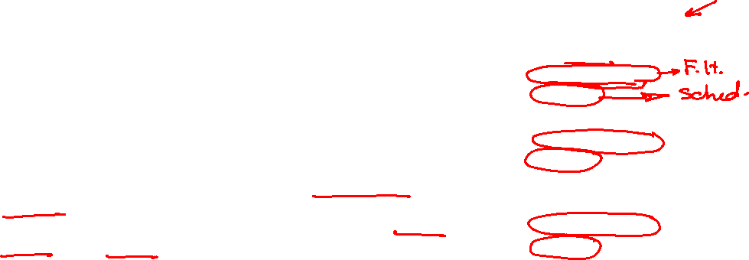
Project ENTIRE Tests: Programs
To run each program: FOS> run <prog name> <WS Size> [<priority>]
To load multiple programs: FOS> load <prog name> <WS Size> [<priority>]
...
FOS> runall
I | Program | Params to Play With!
1 | fos_factorial.c (fact): calculate the factorial of the given integer (recursive code) | Input integer Working set size Priority
2 | fos_fibonacci.c (fib): calculate the Fibonacci value of the given index (recursive code) | Fibonacci index Working set size Priority
3 | arrayOperations_Master.c (arrop): test the shared memory & semaphore modules by creating & initializing a shared array, then run 3 programs that apply different operations on this array (quicksort, mergesort and statistics). The four processes use semaphores for sync. | Array size Initializ. (Asc, Ident., Random) Working set size Priority

Slide 58

Project ENTIRE Tests: Programs
To run each program: FOS> run <prog name> <WS Size> [<priority>]
To load multiple programs: FOS> load <prog name> <WS Size> [<priority>]
...
FOS> runall
I | Program | Params to Play With!
4 | quicksort_noleakage.c (qs1): apply the quick-sort recursive algorithm to sort a pre-initialized array of the given size (using malloc()). The created array will be deleted every time (using free()) | Array size Initializ. (Asc, Desc, Random) Working set size Priority
5 | quicksort_leakage.c (qs2): apply the quick-sort recursive algorithm to sort a pre-initialized array of the given size (using malloc()). The created array will NOT be deleted, leading to memory leakage. | Array size Initializ. (Asc, Desc, Random) Working set size Priority

Slide 59

Project ENTIRE Tests: Programs
To run each program: FOS> run <prog name> <WS Size> [<priority>]
To load multiple programs: FOS> load <prog name> <WS Size> [<priority>]
...
FOS> runall
I | Program | Params to Play With!
6 | mergesort_noleakage.c (ms1): apply the merge-sort recursive algorithm to sort a pre-initialized array of the given size (using malloc()). The auxiliary arrays in the “Merge” function are deleted every time (using free()) | Array size Initializ. (Asc, Desc, Random) Working set size Priority
7 | mergesort_leakage.c (ms2): apply the merge-sort recursive algorithm to sort a pre-initialized array of the given size (using malloc()). The auxiliary arrays in the “Merge” function are NOT deleted (i.e. causing memory leakage) | Array size Initializ. (Asc, Desc, Random) Working set size Priority

Slide 60
Project ENTIRE Tests: Scenarios
Possible Scenarios:
Run Single Program with Different Params
Can be used to test ALL Modules except CPU scheduling
To Run any program:
FOS> run <prog name> <WS Size> [<priority>]
Examples for Some Scenarios
Test the same program with different WS sizes (very small, medium, large and very large sizes)
Compare NORMAL vs. MODIFIED versions of N^{th} Chance Clock algorithm on different WS sizes
Compare mem-leakage program vs. non-leaky ones

Slide 61
Project ENTIRE Tests: Scenarios
Possible Scenarios:
Run Multi-Programs at the Same Time with Different Params
Can be used to test ALL Modules including CPU scheduling
To load multiple programs & run them at once:
FOS> load <prog name> <WS Size> <priority>
FOS> load <prog name> <WS Size> <priority>
…
FOS> runall
Examples for Some Scenarios
Run instances of the same program with different priorities. Play with the starvation threshold.
Run set of programs with different priorities. Play with the starvation threshold.

Slide 62
Bonuses

Slide 63
Bonuses
1. Free the Entire Process (env_free) V.1 (without shared & semaphores)
All pages in the page working set
Working set itself
All page tables in the entire user virtual memory
Directory table
User kernel stack
All pages from page file, this code is already written for you ☺

Slide 64
Bonuses
2. Free the Entire Process (env_free) V.2 (including shared & semaphores)
All pages in the page working set
Working set itself
ALL shared objects (if any)
ALL semaphores (if any)
All page tables in the entire user virtual memory
Directory table
User kernel stack
All pages from page file, this code is already written for you ☺

Slide 65

Bonuses
3. Efficient Implementation of N^{th} Chance Clock Replacement
Implement the main logic of replacement in O(N) (N: WS size)
Neglecting complexity of read/write from/to page file
Compare the performance of this implementation with the naïve one

Slide 66
Bonuses
4. FOS Enhancement
If you discover any issue in the FOS:
Performance issue
Security/Protection issue
Any other design/technical issue to act as a real OS
Try to get a solution for it. (no implementation, just the solution idea)
Fill-up this document with TWO main sections:
The issue explained in a detailed and clear way.
The solution explained in a detailed and clear way.
DELIVERY: Discuss it with the Lecturer in online session isA

Slide 67

Agenda
Logistics
Part 0: Code Updates
Part 1: Fault Handler II (Replacement)
Part 2: User-Level Semaphores
Part 3: Priority RR Scheduler
OVERALL Testing
BONUSES
Summary & Quick Guide
How to submit?

Slide 68
Summary
Module | Function | Difficulty | Testing | Files
Fault Handler II | N^{th} Chance Clock Replacement [NORMAL & MODIFIED] | L3 | [NORMAL Version] FOS> nclock 5 1 FOS> run tpr1 11 FOS> run tpr2 6 FOS> run tnclock1 11 [MODIFIED Version] FOS> nclock 5 2 FOS> run tpr1 11 FOS> run tpr2 6 FOS> run tnclock2 11 | Kern/trap/fault_handler.c
"Congratulations!! test [TEST NAME] completed successfully.”
To ensure the test success, a congratulations message like this MUST appear without any ERROR messages or PANICs.

Slide 69
Summary
Module | Function | Diff. | Testing | Files
User-Level Semaphore | Create Semaphore | L1 | SEEN Tests 1. FOS> run tsem1 100 2. FOS> run tsem2 100 Enter total # cust’s: 100 Enter shop capacity: 30 3. FOS> run midterm 100 UNSEEN Tests | lib/semaphore.c
 | Get Semaphore | L1
 | Wait Semaphore | L2
System Calls | Signal Semaphore | L2 | FOS> run tm1 ➔ malloc PAGE ALLOC FOS> run tm2 ➔ malloc BLOCK ALLOC FOS> run tf1 ➔ free PAGE ALLOC FOS> run tf2 ➔ free BLOCK ALLOC FOS> run tff1 ➔ FF PAGE ALLOC FOS> run tff2 ➔ FF BLOCK ALLOC | lib/uheap.c kern/mem/chunk_operations.c
Module | Function | Diff. | Testing | Files
Priority RR Scheduler | Set Process Priority & Threshold | L2 | Test at your own… UNSEEN Tests | kern/cpu/sched_helpers.c & system call files
 | Initialize Priority RR Scheduler | L2 |  | kern/sched/sched.c, kern/cmd/commands.c
 | Schedule Next Process | L1 |  | kern/sched/sched.c
System Calls | Timer Tick Handler | L1 | FOS> run tm1 ➔ malloc PAGE ALLOC FOS> run tm2 ➔ malloc BLOCK ALLOC FOS> run tf1 ➔ free PAGE ALLOC FOS> run tf2 ➔ free BLOCK ALLOC FOS> run tff1 ➔ FF PAGE ALLOC FOS> run tff2 ➔ FF BLOCK ALLOC | lib/uheap.c kern/mem/chunk_operations.c
Module | Testing | Evaluation
OVERALL TESTING | UNSEEN FIVE Testing Scenarios to test the entire project | 5 MARKS (1/each)

Slide 70
REMEMBER:
UPDATE YOUR CODE ACCORDING TO PREVIOUSLY DESCRIBED STEPS
READ ATATCHED APPENDICES FOR HELPER FUNCTIONS.

Slide 71
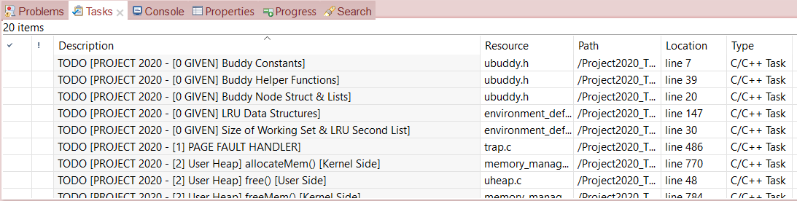
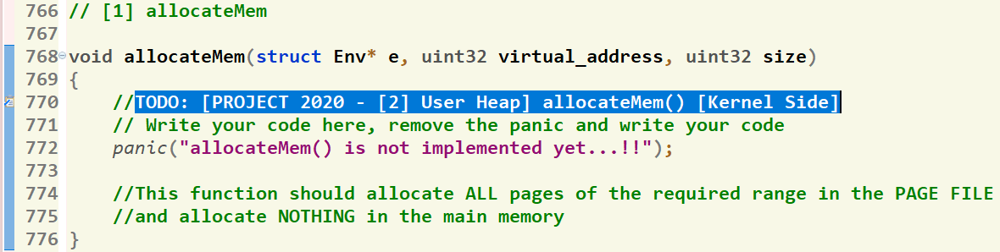
Where should I write the Code?
There’re shortcut links that direct you to the function definition
[1] Click on “Tasks” Tab
[2] Double Click on the required function
GIVEN
REQUIRED
[3] Function body, at which you should write the code
71

Slide 72
Submission Rules
Read the following instructions as the code correction is done AUTOMATICALLY. Any violation in these rules will lead to 0 and, in this case, nothing could be happened.
First ensure the following that (READ CAREFULLY):
You tested each function in a FRESH RUN and a congratulations message have been appeared.
NO CODE with errors WILL BE CORRECTED. So, CLEAN & RUN your project several times before your submission.
You submitted BEFORE the deadline by several hours to AVOID any internet problems.
DEADLINE: of Week #13 (21/12 @11:59 PM)
NO DELAYED submissions WILL BE ACCEPTED.
ONLY ONE person from the team shall submit the code.
The TEAM # MUST BE CORRECT.
DON’T take the FORM LINK FROM ANYONE. OPEN the form from its LINK ONLY. Otherwise, your submission is AUTOMATICALLY CANCELLED by GOOGLE.
You MUST RECEIVE A MAIL FROM GOOGLE with your submission after clicking submit. If nothing received, re-submit again to consider your submission.

Slide 73
Submission Steps
STEPS to SUBMIT:
Step 1: Clean & run your code the last time to ensure that there are any errors.
Step 2: Create a new folder and name it by your team number ONLY. Example 1 or 95. [ANY extra chars will lead to 0].
Step 3: DELETE the “obj” folder from the “FOS_PROJECT_2024_Template”
Step 4: PASTE the “FOS_PROJECT_2024_Template” in the folder created in step #2.
Step 5: Zip the created new folder. Its name shall be like [num of your team.zip]. [ANY extra chars will lead to ZERO].
Step 6: Open the form from HERE.
Step 7: Fill your team’s info .. Any wrong information will cancel your submission, revise them well.
Step 8: Upload the zipped folder in step 5 to the form in its field.
Step 9: MUST RECEIVE A MAIL from GOOGLE with your submission, otherwise re-submit again.

Slide 74
Thank you for your care…
Enjoy making your own OS ☺

